Slide 1


Compiler Construction
Lecture 03

Slide 2
Symbol Table

Slide 3
Objectives
You will learn about;
Unit 3.1 :
  Symbol Table
Unit 3.2 :
  Who Creates a Symbol Table
  Scope of Symbol Table
Unit 3.3 :
  Organizing the Symbol Table

Slide 4
UNIT 3.1
Home
  Symbol Table

Slide 5
Agenda
01
Symbol Table
02
Who Creates a Symbol Table
03
Scope of Symbol Table
04
Organizing the Symbol Table

Slide 6
Symbol Table
Symbol tables are data structures that are used by compilers to hold information
about source-program constructs.
The information is collected incrementally by the analysis phases of a compiler and used by the synthesis phases to generate the target code.
Entries in the symbol table contain information about an identifier such as its character string (or lexeme) , its type, its position in storage, and any other relevant information.

Slide 7
Symbol Table
A symbol table is a table that binds names to information. We need a number of operations on symbol tables to accomplish this:
We need an empty symbol table, in which no name is defined.
We need to be able to bind a name to a piece of information. In case the name is already defined in the symbol table, the new binding takes precedence over the old.
We need to be able to look up a name in a symbol table to find the information the name is bound to. If the name is not defined in the symbol table, we need to be told that.
We need to be able to enter a new scope.
We need to be able to exit a scope, reestablishing the symbol table to what it was before the scope was entered.

Slide 8
UNIT 3.2
Home
  Who creates Symbol Table ?
  Scope of Symbol Table

Slide 9
Who creates Symbol Table Entities?
Symbol-table entries are created and used during the analysis phase by the lexical analyzer, the parser, and the semantic analyzer.
In some cases, a lexical analyzer can create a symbol-table entry as soon as it sees the characters that make up a lexeme.
More often, the lexical analyzer can only return to the parser a token, say id, along with a pointer to the lexeme.
Only the parser, however, can decide whether to use a previously created symbol-table entry or create a new one for the identifier.

Slide 10
Symbol Table Per Scope
The term "scope of identifier x really refers to the scope of a particular declaration
of x.
The term scope by itself refers to a portion of a program that is the scope of one or more declarations.
Scopes are important, because the same identifier can be declared for different
purposes in different parts of a program.
If blocks can be nested, several declarations of the same identifier can appear
within a single block. The following syntax results in nested blocks when stmts
can generate a block:
block -+ '(I decls stmts '3'

Slide 11
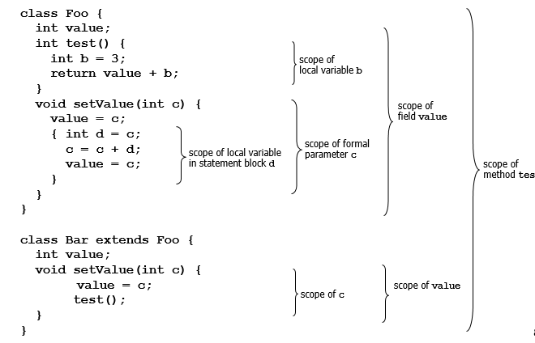
Scope Example

Slide 12
What information is stored in the symbol table?
What items to enter in the symbol table?
Variable names; defined constants; procedure and function names; literal constants and strings; source text labels; compiler-generated temporaries.
What kind of information might the compiler need about each item:
textual name, data type, declaring procedure, storage information. Depending on the type of the object, the compiler may want to know list of fields (for structures), number of parameters and types (for functions), etc…
In practice, many different tables may exist.
Symbol table information is accessed frequently:
hence, efficiency of access is critical!

Slide 13
UNIT 3.3
Home
  Organising the symbol table

Slide 14
Organising the symbol table
Linear List:
  Simple approach, has no fixed size; but inefficient: a lookup may need to traverse the entire list: this takes O(n).
Binary tree:
  An unbalanced tree would have similar behaviour as a linear list (this could arise if symbols are entered in sorted order).
  A balanced tree (path length is roughly equal to all its leaves) would take O(log₂n) probes per lookup (worst-case). Techniques exist for dynamically rebalancing trees.
Hash table:
  Uses a hash function, h, to map names into integers; this is taken as a table index to store information. Potentially O(1), but needs inexpensive function, with good mapping properties, and a policy to handle cases when several names map to the same single index.

Slide 15
Bucket hashing (open hashing)
A hash table consisting of a fixed array of m pointers to table entries.
Table entries are organised as separate linked lists called buckets.
Use the hash function to obtain an integer from 0 to m-1.
As long as h distributes names fairly uniformly (and the number of names is within a small constant factor of the number of buckets), bucket hashing behaves reasonably well.
foo...
qq...
i...

Slide 16
Linear Rehashing (open addressing)
Use a single large table to hold records. When a collision is encountered, use a simple technique (i.e., add a constant) to compute subsequent indices into the table until an empty slot is found or the table is full. If the constant is relatively prime to the table size, this, eventually, will check every slot in the table.
Disadvantages: too many collisions may degrade performance. Expanding the table may not be straightforward.
a
rehash
b
If h(a)=h(b) rehash
(say, add 3).

Slide 17
Linear Rehashing (open addressing)
Choosing a good hash function is of paramount importance:
  take the hash key in four-byte chunks, XOR the chunks together and take this number modulo 2048 (this is the symbol table size). What is the problem with this?
  See the universal hashing function (Cormen, Leiserson, Rivest), Knuth’s multiplicative function… This is one of those cases we should pay attention to theory!

Slide 18
Linear Rehashing (open addressing)
Lexical scoping:
  Many languages introduce independent name scopes:
    C, for example, may have global, static (file), local and block scopes.
    Pascal: nested procedure declarations
    C++, Java: class inheritance, nested classes
    C++, Java, Modula: packages, namespaces, modules, etc…
    Namespaces allow two different entities to have the same name within the same scope: E.g.: In Java, a class and a method can have the same name (Java has six namespaces: packages, types, fields, methods, local variables, labels)
  The problems:
    at point x, which declaration of variable y is current?
    as parser goes in and out of scopes, how does it track y? allocate and initialise a symbol table for each level!

Slide 19
Exercises
Explain why we use Symbol Table?
Give an example of Bucket Hashing?

Slide 20
Thank you

Slide 21
Content Taken From
Compilers Principles, Techniques and Tools by Alfred V. Aho, Ravi Sethi and Jeffry D. Ulman
Basics of Compiler Design, Anniversary edition by Torben Ægidius Mogensen
Web URL:
http://syllabus.cs.manchester.ac.uk/ugt/2019/COMP36512/2017/

